Slide 1
Accuracy and error measures
Evaluation of classifiers

Slide 2
Accuracy
The accuracy of a classifier is given as the percentage of total correct predictions divided by the total number of instances.
If the accuracy of the classifier is considered acceptable, the classifier can be used to classify future data tuples for which the class label is not known.

Slide 3
Predictor Error Measures
Measure predictor accuracy:
measure how far off the predicted value is from the actual known value

Slide 4
Evaluating the Accuracy of a Classifier
Confusion Matrix
ROC curve
Resampling Techniques
Cross validation
Hold out Method
Bootstrapping

Slide 5
Resampling
Resampling methods will help you assess and validate your model so that it performs best on unseen data.
They involve repeatedly drawing samples from a training set and refitting a model of interest on each sample in order to obtain additional information about the fitted model.
This allows us to gain more information that could not be available from fitting the model only once.
Usually, the objective of a data science project is to create a model using training data, and have it make predictions on new data.
Hence, the resampling methods allow us to see how the model would perform on data it has not been trained on, without collecting new data!

Slide 6
Resampling
Idea
Repeatedly draw sub-samples from the given data set
Then use these splits to fit and assess the model
Common methods
Cross-validation
Bootstrap

Slide 7
Resampling
Cross-validation
Improved approach for estimating the test error
Example is k-fold cross-validation
Bootstrap
Quantify the uncertainty of an estimator or method
Returns standard errors or confidence intervals for a coefficient

Slide 8
Cross-validation
Cross-validation is a resampling procedure used to evaluate machine learning models on a limited data sample.
The procedure has a single parameter called k that refers to the number of groups that a given data sample is to be split into

Slide 9
Types of cross validation
Non-Exhaustive Methods
K fold cross validation
Holdout method.
Stratified K-Fold Cross Validation
Exhaustive Methods
Leave-one-out cross validation
Leave-P-Out cross validation

Slide 10
Types of cross validation
Non-Exhaustive Methods
Non-exhaustive cross validation methods, as the name suggests do not compute all ways of splitting the original data.
Exhaustive Methods
This method learns and tests on all possible ways to divide the original sample into a training and a validation set.

Slide 11
Holdout cross-validation
This is a quite basic and simple approach in which we divide our entire dataset into two parts - training data and testing data.
As the name, we train the model on training data and then evaluate on the testing set.
Usually, the size of training data is set more than twice that of testing data, so the data is split in the ratio of 70:30 or 80:20.
In this approach, the data is first shuffled randomly before splitting.
As the model is trained on a different combination of data points, the model can give different results every time we train it, and this can be a cause of instability.
Also, we can never assure that the train set we picked is representative of the whole dataset.
Also when our dataset is not too large, there is a high possibility that the testing data may contain some important information that we lose as we do not train the model on the testing set.

Slide 12
Holdout cross-validation
In the case of holdout cross-validation, the dataset is randomly split into training and validation data.
Generally, the split of training data is more than test data.
The training data is used to induce the model and validation data is evaluates the performance of the model.
The more data is used to train the model, the better the model is. For the holdout cross-validation method, a good amount of data is isolated from training.
Cons:
Not suitable for an imbalanced dataset.
A lot of data is isolated from training the model.

Slide 13
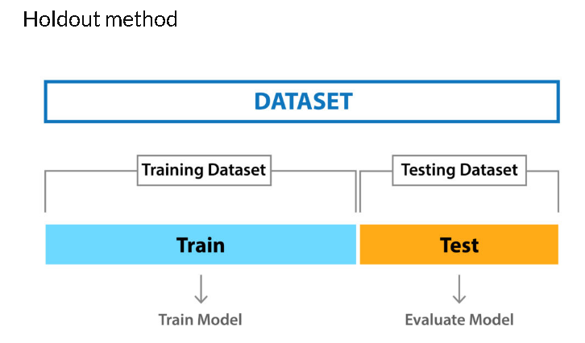
Holdout cross-validation

Slide 14
k-fold cross validation
In k-fold cross-validation, the original dataset is equally partitioned into k subparts or folds of equal size.
Out of the k-folds or groups, for each iteration, one group is selected as validation data, and the remaining (k-1) groups are selected as training data.
The process is repeated for k times until each group is treated as validation and remaining as training data.
The final accuracy of the model is computed by taking the mean accuracy of the k-models validation data.

Slide 15
k-fold cross validation
K-fold cross validation is one way to improve the holdout method. This method guarantees that the score of our model does not depend on the way we picked the train and test set.
The data set is divided into k number of subsets and the holdout method is repeated k number of times.
steps:
Randomly split your entire dataset into k number of folds (subsets)
For each fold in your dataset, build your model on k – 1 folds of the dataset. Then, test the model to check the effectiveness for kth fold
Repeat this until each of the k-folds has served as the test set

Slide 16
k-fold cross validation
The average of your k recorded accuracy is called the cross-validation accuracy and will serve as your performance metric for the model.
Because it ensures that every observation from the original dataset has the chance of appearing in training and test set, this method generally results in a less biased model compare to other methods.
It is one of the best approaches if we have limited input data.
The disadvantage of this method is that the training algorithm has to be rerun from scratch k times, which means it takes k times as much computation to make an evaluation.
Depending on your dataset, you can select a k value of your own. But in most cases, k = 5 or k = 10 is preferred.

Slide 17
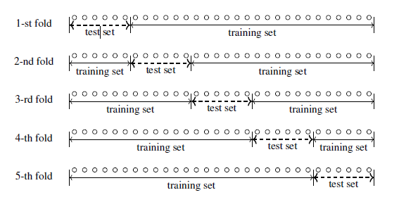
5 fold validation.
Suppose we have 30 samples of data.
To perform 5 fold validation ,divide total number of samples by total fold which gives number of samples in each fold

Slide 18
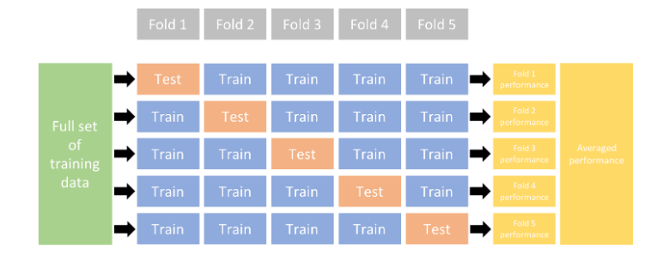

Slide 19
Stratified K Fold Cross Validation
In some cases, data might not have been divided properly between the training and validation sets.
Since we are randomly shuffling the data and then dividing it into folds, chances are we may get highly imbalanced folds which may cause our training to be biased.
For example, let us somehow get a fold that has majority belonging to one class(say positive) and only a few as negative class.

Slide 20
Stratified K-Fold Cross Validation
Stratified K-Fold Cross Validation is a modified form of K-Fold Cross Validation method
Stratification is the process of rearranging the data so as to ensure that each fold is a good representative of the whole such that in each set, we make sure there are equal or close to equal results of all categories.
For example, in a binary classification problem where each class comprises of 50% of the data, it is best to arrange the data such that in every fold, each class comprises of about half the instances.
This variation of K-Fold is known as the Stratified K-Fold Cross Validation.

Slide 21
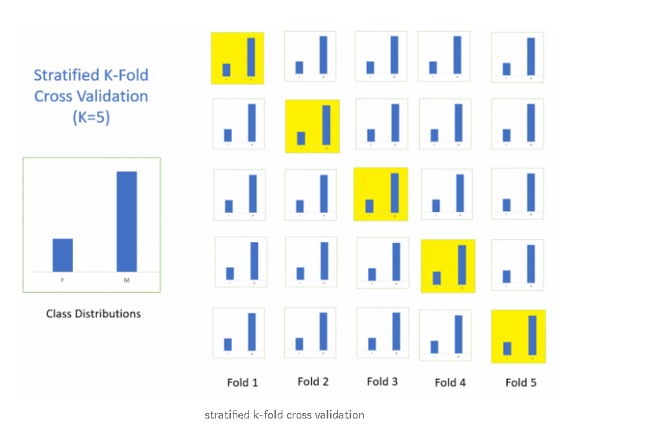
Stratified K-Fold Cross Validation

Slide 22
Leave-P-Out cross validation
In Leave-P-Out cross validation we take p number of points randomly out from the total number of data points in the dataset(say n).
And train the model on these (n – p) data points and test the model on p data points
Since this is also an exhaustive method, all possible combinations of p samples must be used

Slide 23
Leave-P-Out cross validation
We repeat this process for all the possible combinations of p from the original dataset.
Then to get the final accuracy, we average the accuracies from all these iterations.
Remember if we choose a higher value for p, then the number of combinations will be more and we can say the method gets a lot more exhaustive.

Slide 24
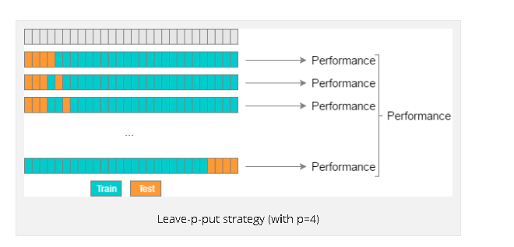
Leave-P-Out cross validation(with p=4)

Slide 25
Leave-one-out cross validation(LOOCV)
This is a simple variation of Leave-P-Out cross validation and the value of p is set as one.
Given a dataset of N instances only one instance is left out as the validation set and training uses the remaining N-1 instances.
Will get N separate folds
Makes best use of the data
Involves no random subsampling
Computation time is too high
This method is used when the data set is very small.

Slide 26
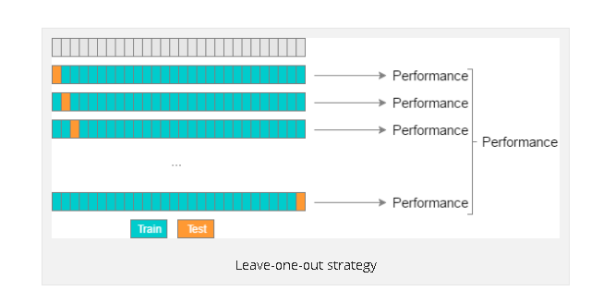
Leave-one-out cross validation(LOOCV)

Slide 27
University question
Given a data set with 1200 instances, how k- fold cross validation is done with k=1200. (4 marks)

Slide 28
Bootstrapping
A bootstrap sample is a random sample of the data taken with replacement .
This means that, after a data point is selected for inclusion in the subset, it’s still available for further selection.
A bootstrap sample is the same size as the original data set from which it was constructed.

Slide 29
Bootstrapping
From a dataset with N sample this technique will randomly select (with replacement) N and use this set for training
The original observations not contained in training set are considered out-of-bag (OOB) and it is used for testing
When bootstrapping, a model can be built on the selected samples and validated on the OOB samples; this is often done, for example, in random forests
The error value is likely to change from fold to fold
Repeat this process for specified number of folds
The error value is estimated as the average of the error rate on test sample

Slide 30
Bootstrapping example (N=5)
Suppose we have the data set X1,X2,X3,X4,X5
Training Set
(bootstrap sample ) Test set(OOB)
Case 1 : X1,X3,X3,X3,X5 X2 ,X4
Case 2: X5,X5,X3,X1,X2 X4
Case 3: X5,X5,X1,X2,X1 X3,X4

Slide 31
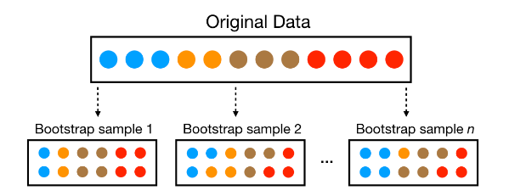

Slide 32
Since samples are drawn with replacement, each bootstrap sample is likely to contain duplicate values.
In fact, on average, ≈63.21≈63.21% of the original sample ends up in any particular bootstrap sample.
When bootstrapping, a model can be built on the selected samples and validated on the OOB samples; this is often done, for example, in random forests

Slide 33
Confusion matrix
A Confusion matrix is an N x N matrix used for evaluating the performance of a classification model, where N is the number of target classes.
The matrix compares the actual target values with those predicted by the machine learning model.
This gives us a holistic view of how well our classification model is performing and what kinds of errors it is making.

Slide 34
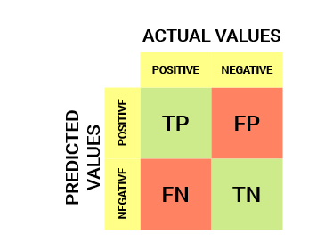
Confusion matrix
The target variable has two values: Positive or Negative
The columns represent the predicted values of the target variable
The rows represent the actual values of the target variable

Slide 35
Understanding True Positive, True Negative, False Positive and False Negative in a Confusion Matrix
True Positive (TP)
The predicted value matches the actual value
The actual value was positive and the model predicted a positive value
True Negative (TN)
The predicted value matches the actual value
The actual value was negative and the model predicted a negative value
False Positive (FP) – Type 1 error
The predicted value was falsely predicted
The actual value was negative but the model predicted a positive value
Also known as the Type 1 error
False Negative (FN) – Type 2 error
The predicted value was falsely predicted
The actual value was positive but the model predicted a negative value
Also known as the Type 2 error

Slide 36
Understanding True Positive, True Negative, False Positive and False Negative in a Confusion Matrix
True Positive (TP)
The predicted value matches the actual value
The actual value was positive and the model predicted a positive value
True Negative (TN)
The predicted value matches the actual value
The actual value was negative and the model predicted a negative value
False Positive (FP) – Type 1 error
The predicted value was falsely predicted
The actual value was negative but the model predicted a positive value
Also known as the Type 1 error
False Negative (FN) – Type 2 error
The predicted value was falsely predicted
The actual value was positive but the model predicted a negative value
Also known as the Type 2 error

Slide 37
Understanding True Positive, True Negative, False Positive and False Negative in a Confusion Matrix
True Positive (TP)
The predicted value matches the actual value
The actual value was positive and the model predicted a positive value

Slide 38
Understanding True Positive, True Negative, False Positive and False Negative in a Confusion Matrix
True Negative (TN)
The predicted value matches the actual value
The actual value was negative and the model predicted a negative value

Slide 39
Understanding True Positive, True Negative, False Positive and False Negative in a Confusion Matrix
False Positive (FP) – Type 1 error
The predicted value was falsely predicted
The actual value was negative but the model predicted a positive value
Also known as the Type 1 error

Slide 40
Understanding True Positive, True Negative, False Positive and False Negative in a Confusion Matrix
False Negative (FN) – Type 2 error
The predicted value was falsely predicted
The actual value was positive but the model predicted a negative value
Also known as the Type 2 error

Slide 41
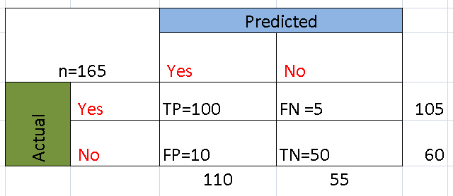
EXAMPLE POSITIVE-YES NEGATIVE –NO

Slide 42
Example
TP & FP means predicted positives
TP & FN means total actual positives .

Slide 43
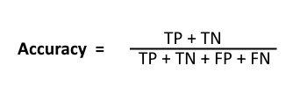
Classification Rate/Accuracy:
Classification Rate or Accuracy is given by the relation:

Slide 44

Sensitivity / True Positive Rate / Recall
Recall:the ratio of the total number of correctly classified positive examples divide to the total number of positive examples.
High Recall indicates the class is correctly recognized

Slide 45
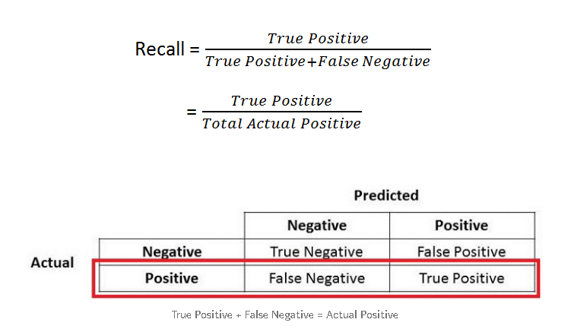

Slide 46

Precision
Precision:total number of correctly classified positive examples by the total number of predicted positive examples.
High recall, low precision:This means that most of the positive examples are correctly recognized (low FN) but there are a lot of false positives.
Low recall, high precision:This shows that we miss a lot of positive examples (high FN) but those we predict as positive are indeed positive (low FP)

Slide 47
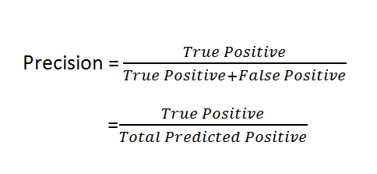
Precision

Slide 48
F1 score
F1 score (also F-score or F-measure) is a measure of a test's accuracy.
The F1 score is the harmonic mean of the precision and recall.
The highest possible value of F1 is 1, indicating perfect precision and recall, and the lowest possible value is 0, if either the precision or the recall is zero
It is calculated from the precision and recall of the test, where the precision is the number of correctly identified positive results divided by the number of all positive results, including those not identified correctly, and the recall is the number of correctly identified positive results divided by the number of all samples that should have been identified as positive.

Slide 49

F1 score(F-MEASURE)

Slide 50
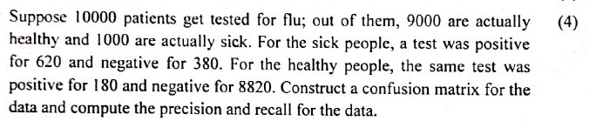
University question

Slide 51
N=10000
Predicted
Flue=Yes
Flue=No
Actual
Flue=Yes
Flue=No

Slide 52
N=10000
Predicted
Recall=TP/(TP+FN)
=620/(620+380)
=0.62
Flue=Yes
Flue=No
Actual
TP=620 | FN=380
FP=180 | FN=8820
Flue=Yes
1000
Precision=TP/(TP+FP2
=620/(620+180)
=0.77
Flue=No
9000

Slide 53
Problem 1
Suppose a computer program for recognizing dogs in photographs identifies eight dogs in a picture containing 12 dogs and some cats. Of the eight dogs identified, five actually are dogs while the rest are cats. Compute the precision and recall of the computer program.

Slide 54
Predicted
Dog=Yes
Dog=No
Actual
TP=5 | FN=7
FP=3 | FN=
Dog=Yes
12
Dog=No
8

Slide 55
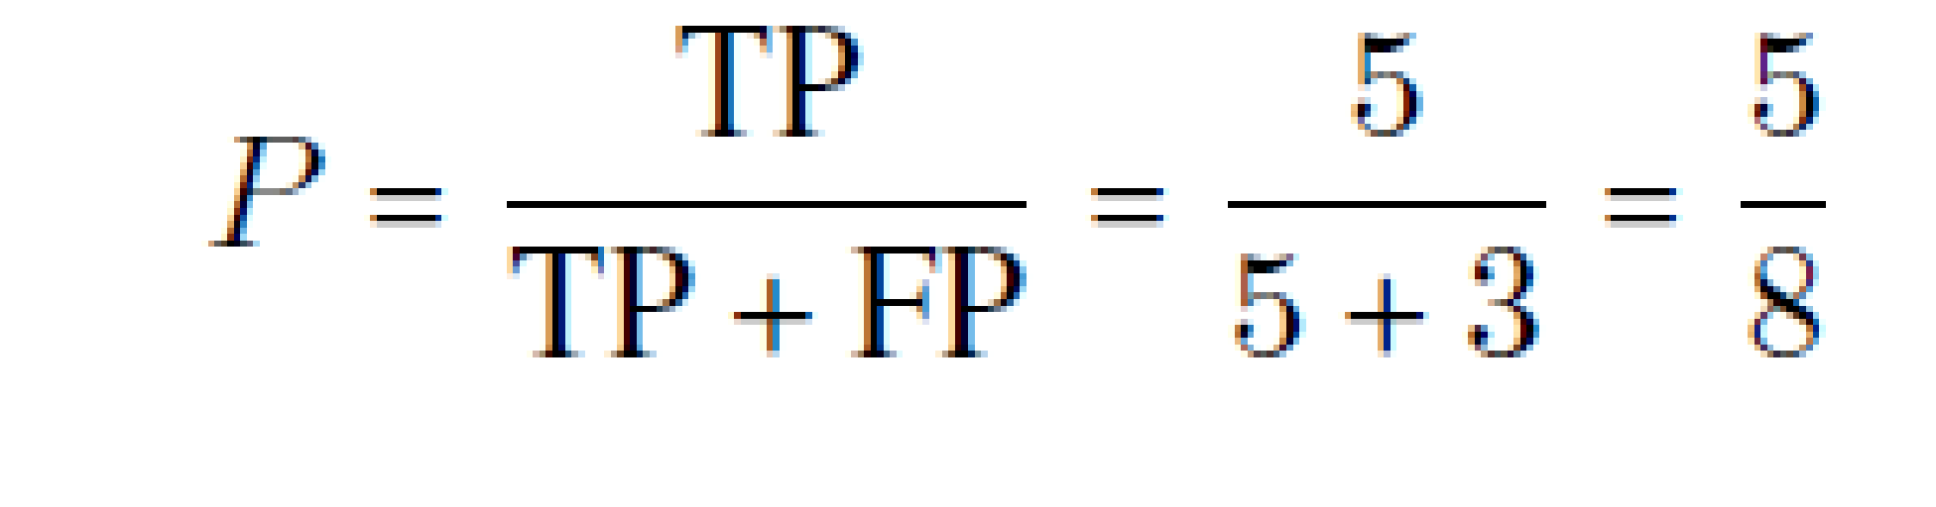
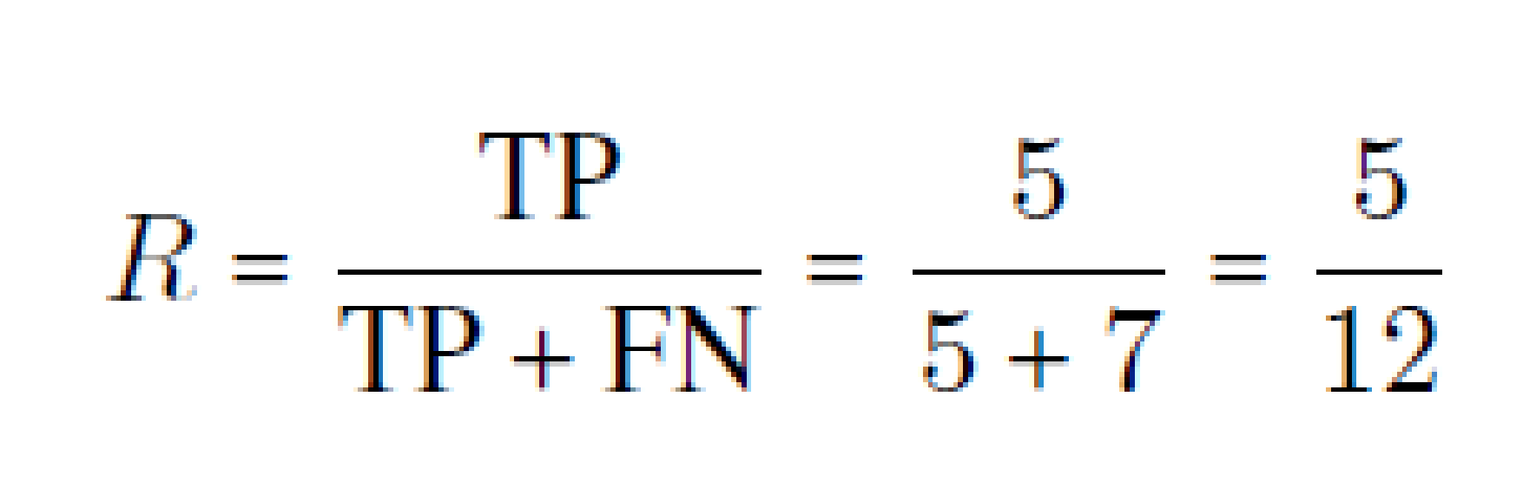
Problem 1
Suppose a computer program for recognizing dogs in photographs identifies eight dogs in a picture containing 12 dogs and some cats. Of the eight dogs identified, five actually are dogs while the rest are cats. Compute the precision and recall of the computer program.
TP =5
FP = 3
FN = 7
The precision P is
The recall R is

Slide 56
Problem 2
Let there be 10 balls (6 white and 4 red balls) in a box and let it be required to pick up the red balls from them. Suppose we pick up 7 balls as the red balls of which only 2 are actually red balls. What are the values of precision and recall in picking red ball?
Actual
Red= yes
Red= no
TP=2 | FN=2
FP=5 | FN=
Red= yes
4
Predicted
Red= no
6
7

Slide 57
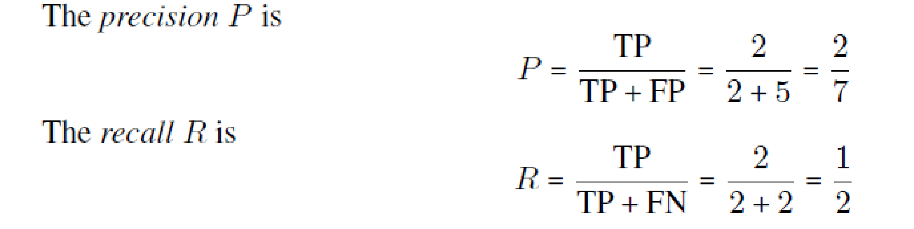
Problem 2
Let there be 10 balls (6 white and 4 red balls) in a box and let it be required to pick up the red balls from them. Suppose we pick up 7 balls as the red balls of which only 2 are actually red balls. What are the values of precision and recall in picking red ball?
TP =2
FP = 7-2 =5
FN = 4-2=2

Slide 58
Why you need Confusion matrix?
Here are pros/benefits of using a confusion matrix.
It shows how any classification model is confused when it makes predictions.
Confusion matrix not only gives you insight into the errors being made by your classifier but also types of errors that are being made.
This breakdown helps you to overcomes the limitation of using classification accuracy alone.
Every column of the confusion matrix represents the instances of that predicted class.
Each row of the confusion matrix represents the instances of the actual class.
It provides insight not only the errors which are made by a classifier but also errors that are being made.

Slide 59
Specificity / True Negative Rate
Specificity is defined as the proportion of actual negatives, which got predicted as the negative (or true negative).
Mathematically, specificity can be calculated as the following:
Specificity = (True Negative)/(True Negative + False Positive)
Specificity tells us what proportion of the negative class got correctly classified.

Slide 60
What Are the Differences Between Sensitivity and Specificity?
While Sensitivity measure is used to determine the proportion of actual positive cases, which got predicted correctly
Specificity measure is used to determine the proportion of actual negative cases, which got predicted correctly.

Slide 61
Where Are Sensitivity and Specificity Used?
Sensitivity and Specificity measures are used to plot the ROC curve.
And, Area under ROC curve (AUC) is used to determine the model performance

Slide 62
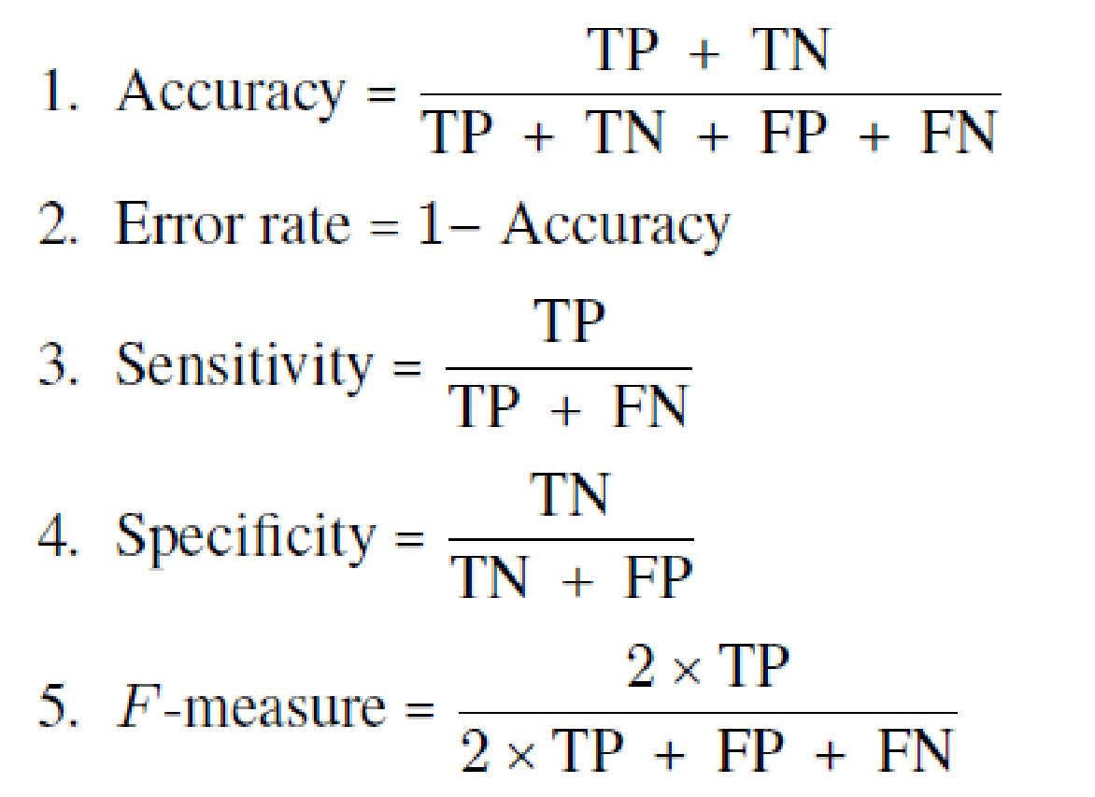
Other measures of performance

Slide 63
Receiver Operating Characteristic (ROC)
ROC stands for Receiver Operating Characteristic
The ROC curve was first developed by electrical engineers and radar engineers during World War II for detecting enemy objects in battlefields.
They are now increasingly used in machine learning and data mining research.

Slide 64
ROC curve
An ROC curve (receiver operating characteristic curve) is a graph showing the performance of a classification model at all classification thresholds.
It is used to evaluate logistic regression classification models
This curve plots two parameters:
True Positive Rate
False Positive Rate

Slide 65
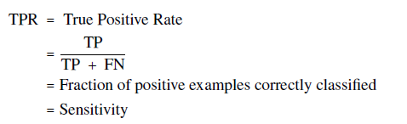
Recall/True positive rate/sensitivity

Slide 66
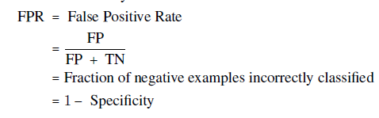
False positive rate

Slide 67
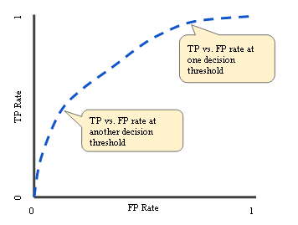
An ROC curve plots TPR vs. FPR at different classification thresholds.
Lowering the classification threshold classifies more items as positive, thus increasing both False Positives and True Positives.
The following figure shows a typical ROC curve.

Slide 68
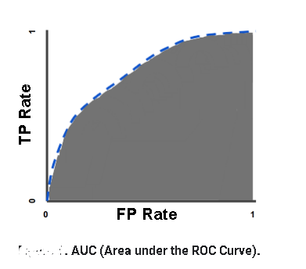
AUC: Area Under the ROC Curve
AUC stands for "Area under the ROC Curve."
That is, AUC measures the entire two-dimensional area underneath the entire ROC curve (think integral calculus) from (0,0) to (1,1).

Slide 69
AUC: Area Under the ROC Curve
The value of AUC is a measure of the performance of a classifier.
For the perfect classifier, AUC = 1.0.
The Area Under the Curve (AUC) is the measure of the ability of a classifier to distinguish between classes
The higher the AUC, the better the performance of the model at distinguishing between the positive and negative classes.

Slide 70
Special points in ROC space
The left bottom corner point (0; 0): Always negative prediction
2. The right top corner point (1; 1): Always positive prediction
3. The left top corner point (0; 1): Perfect prediction
4. Points along the diagonal: Random performance

Slide 71
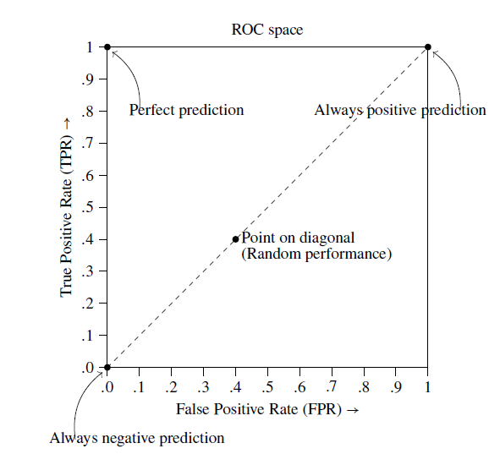
Special points in ROC space

Slide 72
Special points in ROC space
1. The left bottom corner point (0; 0): Always negative prediction
A classifier which produces this point in the ROC space never classifies an example as positive,neither rightly nor wrongly, because for this point TP = 0 and FP = 0.
It always makes negative predictions.
All positive instances are wrongly predicted and all negative instances are correctly predicted. It commits no false positive errors.
2. The right top corner point (1; 1): Always positive prediction
A classifier which produces this point in the ROC space always classifies an example as positive because for this point FN = 0 and TN = 0.
All positive instances are correctly predicted and all negative instances are wrongly predicted.
It commits no false negative errors.

Slide 73
Special points in ROC space
3. The left top corner point (0; 1): Perfect prediction
A classifier which produces this point in the ROC space may be thought as a perfect classifier.
It produces no false positives and no false negatives.
4. Points along the diagonal: Random performance
Consider a classifier where the class labels are randomly guessed, say by flipping a coin.
Then, the corresponding points in the ROC space will be lying very near the diagonal line joining the points (0; 0) and (1; 1).

Slide 74
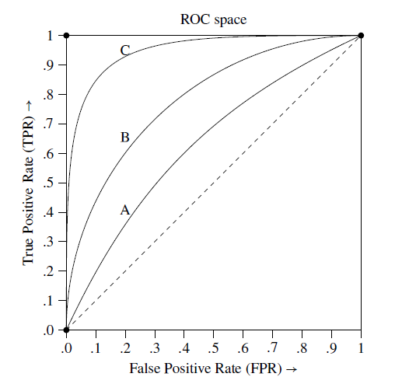
ROC curves of three different classifiers A, B, C

Slide 75
ROC curves of three different classifiers A, B, C
The closer the ROC curve is to the top left corner (0; 1) of the ROC space, the better the accuracy of the classifier.
Among the three classifiers A, B, C with ROC curves as shown in Figure ,the classifier C is closest to the top left corner of the ROC space.
Hence, among the three, it gives the best accuracy in predictions.

Slide 76
Error Measures

Slide 77
Loss function:
measures the error between. yi and the predicted value yi ’
Absolute error: | yi – yi’|
Squared error: (yi – yi’) 2

Slide 78
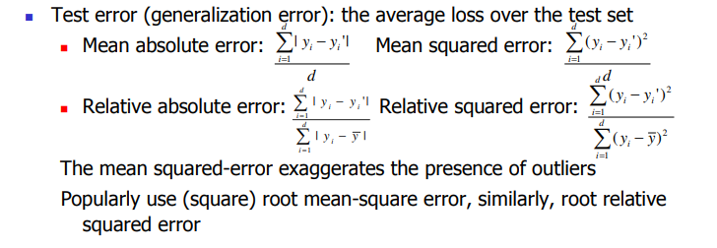

Slide 79

Mean absolute error
Absolute Error is the amount of error in your measurements.
It is the difference between the measured value and “true” value
The Mean Absolute Error(MAE) is the average of all absolute errors. The formula is:
Where:
n = the number of errors,
Σ = summation symbol (which means “add them all up”),
|x_{i} – x| = the absolute errors.

Slide 80
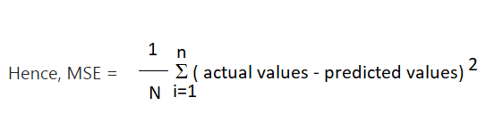
Mean Squared Error or MSE
MSE is calculated by taking the average of the square of the difference between the original and predicted values of the data.

Slide 81
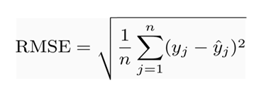
Root mean squared error (RMSE):
RMSE is a quadratic scoring rule that also measures the average magnitude of the error.
It’s the square root of the average of squared differences between prediction and actual observation.

Slide 82
Accuracy
The accuracy of a classifier is given as the percentage of total correct predictions divided by the total number of instances.
If the accuracy of the classifier is considered acceptable, the classifier can be used to classify future data tuples for which the class label is not known.

Slide 83
Predictor Error Measures
Measure predictor accuracy:
measure how far off the predicted value is from the actual known value

Slide 84
Loss function:
measures the error between. yi and the predicted value yi ’
Absolute error: | yi – yi’|
Squared error: (yi – yi’) 2

Slide 86
Mean absolute error
Absolute Error is the amount of error in your measurements.
It is the difference between the measured value and “true” value
The Mean Absolute Error(MAE) is the average of all absolute errors. The formula is:
Where:
n = the number of errors,
Σ = summation symbol (which means “add them all up”),
|x_{i} – x| = the absolute errors.

Slide 87
Mean Squared Error or MSE
MSE is calculated by taking the average of the square of the difference between the original and predicted values of the data.

Slide 88
Root mean squared error (RMSE):
RMSE is a quadratic scoring rule that also measures the average magnitude of the error.
It’s the square root of the average of squared differences between prediction and actual observation.

